Slide 1

Spotify Song Genre Prediction
Ivan Escalona, Daisy Khamphakdy, Iris Lew, Shuo Wang, Amanda Teschko
W207, MIDS

Slide 2
Dataset
Kaggle link: https://www.kaggle.com/datasets/mrmorj/dataset-of-songs-in-spotify
Dimension: 42305 rows x 22 columns
Features:
‘danceability', 'energy', 'key', 'loudness', 'mode', 'speechiness', 'acousticness', 'instrumentalness', 'liveness', 'valence', 'tempo', 'type', 'id', 'uri', 'track_href', 'analysis_url', 'duration_ms', 'time_signature', 'genre', 'song_name', 'Unnamed: 0', 'title'
Data dictionary:
https://developer.spotify.com/documentation/web-api/reference/#/operations/get-audio-features
https://docs.google.com/document/d/1LWl88F8wGY1WkkOSzzVzwSYij1yeMR8hFXllRpkMyrI/edit
Notes:
SHUO
Introduce the dataset

Slide 3
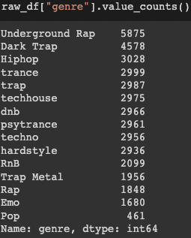
Goal:
Goal: Spotify executives have asked the data science team to have its music app automatically recognize a song’s genre when a song plays, rather than manually classifying a song genre. This will help improve song library customization by learning what song genres are listened to most.
How?: The data science team will build machine learning models that will learn to distinguish songs based on key audio features. The team will then determine the best model for predicting and recognizing song genres.
Notes:
SHUO
Introduce:
Spotify
The dataset

Slide 4
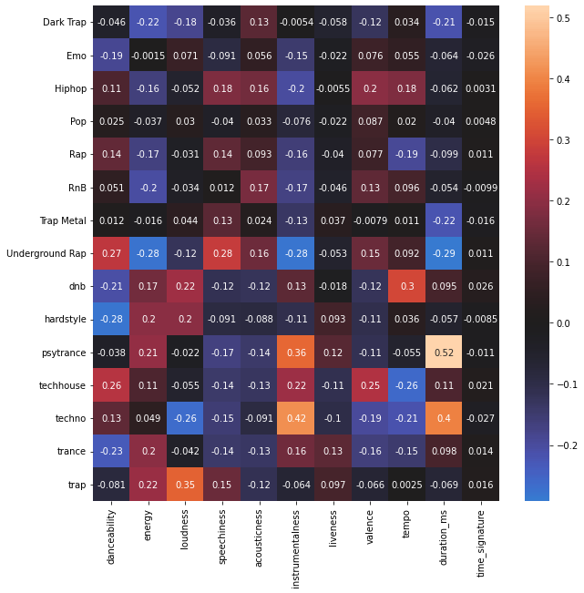
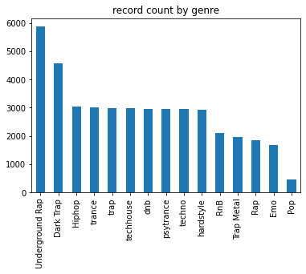
EDA & Findings - Target Variable
15 genres exist in the data
Underground Rap is the most common; Pop is the least common
Notes:
AMANDA (SHUO)
We began by understanding more about our target variable: genre. We looked at record counts and then we used a OHE on genre to look at the correlation between that genre and some of the numeric attributes in the data.

Slide 5
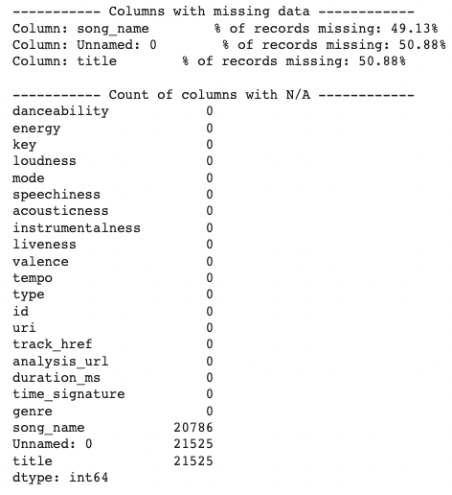
EDA & Findings
Missing data:
Dropped song_name and Unnamed:0 columns because too much data was missing (~50% missing)
Notes:
AMANDA (SHUO)
We then began exploring the variables to determine where we had large amounts of missing data, and also by looking to get a feel for where our columns might be numeric or categorical variables.

Slide 6
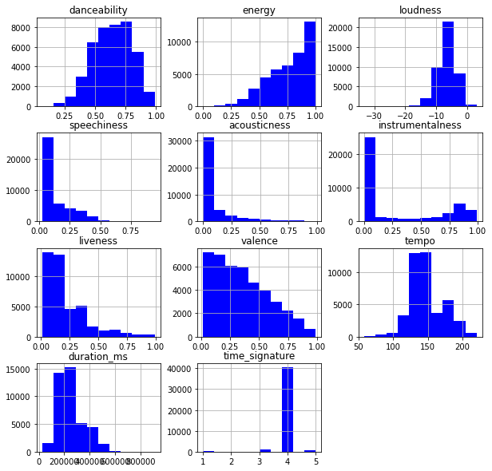
EDA & Findings - Numeric Variable Histograms
Danceability, loudness, and tempo have roughly normal distributions
Speechiness, acousticness, and instrumentalism have large spikes at 0, suggesting a large number of songs don’t have these characteristics present
Time signature has only 5 values and may be better considered categorically
Notes:
AMANDA (SHUO)
For the numeric variables, we started by looking at the histograms for each….We identified some interesting characteristics for the distributions of some of our variables (refer to bullet points); and also decided that though time series initially looked numeric, it may actually represent a categorical variable because it only has 5 values. We could also see from the histograms that many (but not all) of the variables range from 0-1.

Slide 7
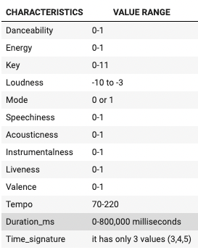
EDA & Findings - Numeric Variable Ranges
Value ranges are 0-1 for most features, but not all
We may want to scale loudness, tempo, and duration to have a value between 0 and 1.
Time_signature and Key may be best used as categorical or ordinal variables
Notes:
AMANDA (DAISY)
That caused us to look more closely at the ranges for each of the numeric variables. Many of the variables were already standardized between 0 and 1. However, we identified that some were not.
We thought it might be beneficial to scale (or normalize) a few variables so that they too have a value that ranged between 0-1.
We also reaffirmed that time_signature should be categorical, and decided that key should also be handled categorically.

Slide 8
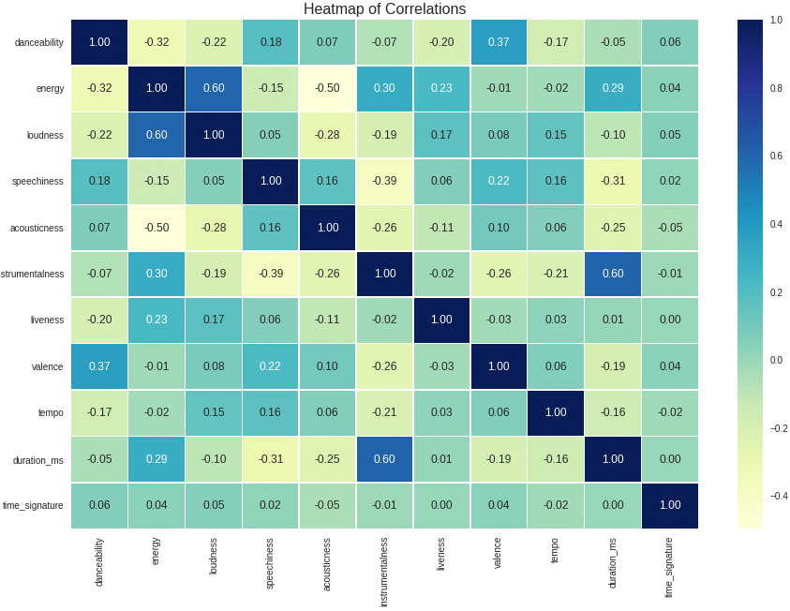
EDA & Findings - Numeric Variable Correlations
Some correlation exists between:
Energy and loudness (.6)
Instrumentalness and duration (.6)
Acousticness and energy (-.5)
Correlation isn’t so high that we’d exclude variables in initial models
Notes:
AMANDA (DAISY)
We also looked at for our numeric variables and the correlation between the variables.
We found a few instances of higher correlation, but nothing that was too worrying (refer to bullets).
The highest correlation was between energy and loudness and instrumentalness and duration at .6. That made sense.
Acousticnes and energy had the lowest at -.5. Also makes sense with slower songs not having high energy.

Slide 9
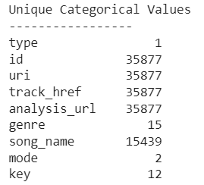
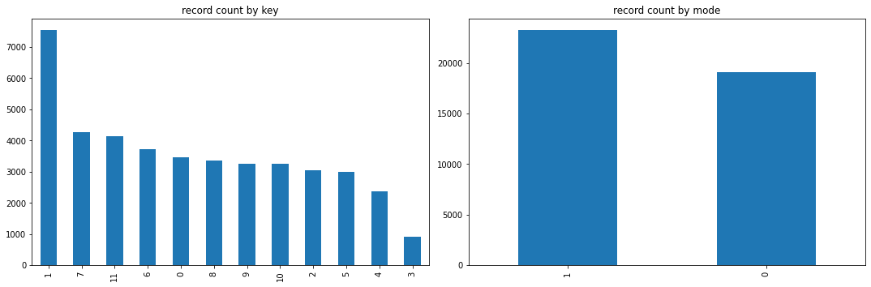
EDA & Findings - Categorical Features
Categorical columns:
Remove columns with a unique value per record -> id, uri, track_href, analysis_url
Removed ‘type’ because all had the same value
Only Key and Mode made sense to include
Notes:
AMANDA (IRIS)
For the categorical features, we began by taking a look at how many unique values existed in our dataset. We recognized that some features are 1:1 with the record id and decided those would not add any value to our model. [refer to bullet]. We can drop those values (but we’ll do one thing with the id column first before dropping it). We also removed variables that only had one value, such as Type. That left us with just two variables - a binary variable for mode and a categorical variable for key.

Slide 10
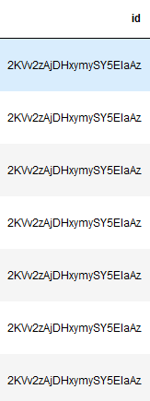
EDA & Findings - Duplicates
If we examine by id, there are duplicates, but every row is unique when we examine the complete dataset.
There are 6,428 duplicates, and after dropping them, we are left with 35,877 rows.
Notes:
IRIS
As mentioned earlier, we want every row to have a unique value. Most of the features are the same except the categorical columns we dropped, so we de-duplicate and end up with a unique id for each row.

Slide 11
EDA & Findings - Outliers
Numeric Feature | % of outliers
danceability | 0.11
energy | 0.33
loudness | 1.88
speechiness | 4.53
acousticness | 12.17
instrumentalness | 0.00
liveness | 5.90
valence | 0.00
tempo | 1.26
duration_ms | 2.88
time_signature | 4.44
Outlier detection method
1.5IQR method
IQR = Q3 - Q1
Any data point outside (-1.5IQR, 1.5*IQR) is considered an outlier
Results
Some good features with less than 1% of outliers (including a couple zeros)
Some in the range of 1% to 3% and some even as high as 12%.
What will we do?
Analyze whether there’s significant data loss if we were to delete those records.
Worse case scenario (unlikely): 14k records will be deleted.
Notes:
IVAN

Slide 12
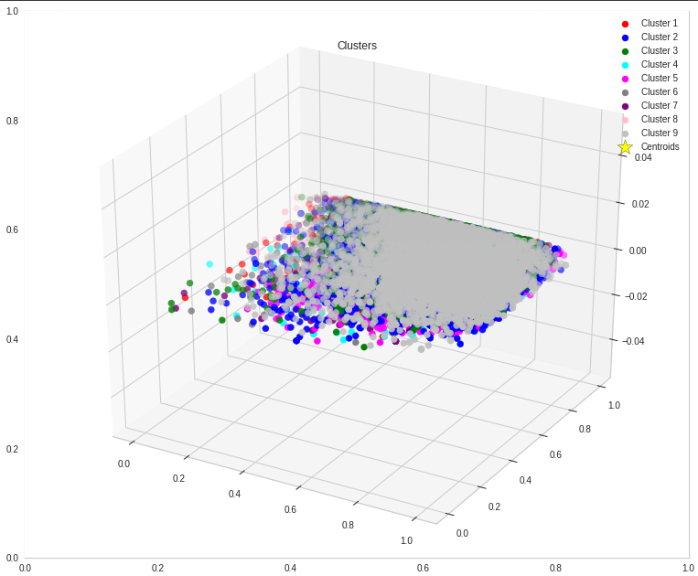
How will we solve the problem?
Build, test, and compare machine learning models to determine the best model for song genre prediction.
Kmeans
KNN
Logistic Regression
Random Forest
Gradient Boosting
Neural Network
Notes:
Explain why we are testing each model and what we expect to find:
DAISY:
Kmeans (unsupervised) - unsupervised clustering algorithm where similar data points are grouped together to discover underlying patterns with no fixed labelled outcomes. We wanted to identify meaningful groups and clusters based on similarities in song characteristics. Realized, may not be the most appropriate model because its unsupervised learning and we already have information on features and the genres. This led us to explore other models.
1. Scaled data to have feature values ranging from 0-1.
2. Used Kmeans (to initialize) and fit_predict() to find the predicted clusters for the training data and its labels of clusters.
KNN (supervised) - One of the models we wanted to explore was K Nearest Neighbor. Which is a supervised classification/regression algorithm. We wanted to use KNN to calculate the distance between k number of labelled data points, classifying the point based on the number of votes that it gets from the k-nearest data points.
1. Select the K number of neighbors
2. Calculate the Euclidean distance of K number of neighbors
3. Get members of each category and assign new data points to a neighbor category
Pros: Easy to implement and interpret, works well with classification and multiple classes.
Cons: KNN runs the risk of overfitting. K controls the size of the neighborhood used to model the local statistical properties, so choosing the right K can be complicated. A very small value for K makes the model more sensitive to local anomalies(outliers), giving too many weight to these particular points. Knowing this, we still thought it would be good to compare as its a commonly used algorithm.
IRIS:
Logistic regression - supervised learning algorithm where each of the classifiers are trained as binary classifiers. They are x% likely to be of Genre 1 vs. y% likely to be of Genre 2. We apply a softmax normalization function to scale the scores and produce which genre the song most likely belongs to.
Random Forest - Build decision trees which uses each tree to predict an output. If feature 1 is > than a criteria, go down one branch, else go down the other. Continue.
IVAN:
Gradient Boosting -
Neural Network -

Slide 13
Random Forest example
Numeric Feature | precision | recall | f1-score | support
Dark Trap | 0.5275 | 0.4607 | 0.4918 | 458
Emo | 0.7622 | 0.6488 | 0.7010 | 168
Hiphop | 0.4960 | 0.4059 | 0.4465 | 303
Pop | 0.0000 | 0.0000 | 0.0000 | 46
Rap | 0.7833 | 0.2541 | 0.3837 | 185
RnB | 0.4709 | 0.3857 | 0.4241 | 210
Trap Metal | 0.4490 | 0.2256 | 0.3003 | 195
Underground Rap | 0.4207 | 0.6865 | 0.5217 | 587
dnb | 0.9631 | 0.9663 | 0.9647 | 297
hardstyle | 0.8243 | 0.8776 | 0.8501 | 294
psytrance | 0.9338 | 0.9054 | 0.9194 | 296
techhouse | 0.8635 | 0.9158 | 0.8889 | 297
techno | 0.8885 | 0.8615 | 0.8748 | 296
trance | 0.7982 | 0.8833 | 0.8386 | 300
trap | 0.8125 | 0.8696 | 0.8401 | 299
 |  |  | Test accuracy | 0.6814
Hyperparameters
max_depth=None
n_estimators=460,
criterion='gini',
max_features = 'sqrt',
min_samples_split = 6,
min_samples_leaf=9
The rest are the default parameters
Notes:
Ivan

Slide 14
What’s pending?
Machine Learning Models
Supervised
Rank | Model | Train Accuracy | Test Accuracy
1 | XGBoost | 0.7794 | 0.6972
2 | Random Forest | 0.7850 | 0.6814
3 | KNN (K=1) | 0.9321 | 0.3836
4 | Logistic Regression | 0.2222 | 0.2200
5 | Neural Network | 0.1736 | 0.0000
Outlier analysis
Complete the development of the K-Means model
Improve accuracy on some of the models
Debug Neural Network model
Compare and analyze models
Notes:
Ivan

Slide 15
Thank you all for your attention!
Questions? Comments?

Slide 16
Old Slides

Slide 17
How will we solve the problem?
Feature developing
Ratio, eg: instrumentalness / liveness
Multiply, eg: speechiness x Danceability
etc.
Correlation
Energy vs Loudness
Etc.

Slide 18
Problem Statement
Genre prediction based on song characteristics
Create clusters & kmeans
Song title - multiclass classification
more rnb songs have ‘love’, etc.
smaller dataset. (Non english songs in dataset)
Business case (algorithm and classify it for spotify internally)
Song recommendation (KNN, kmeans, etc.)
Similar song played next?
business scenario of the next closest song
Song with a different genre
Measure of success
Notes:
Problem statement
Identify business case scenario

Slide 19
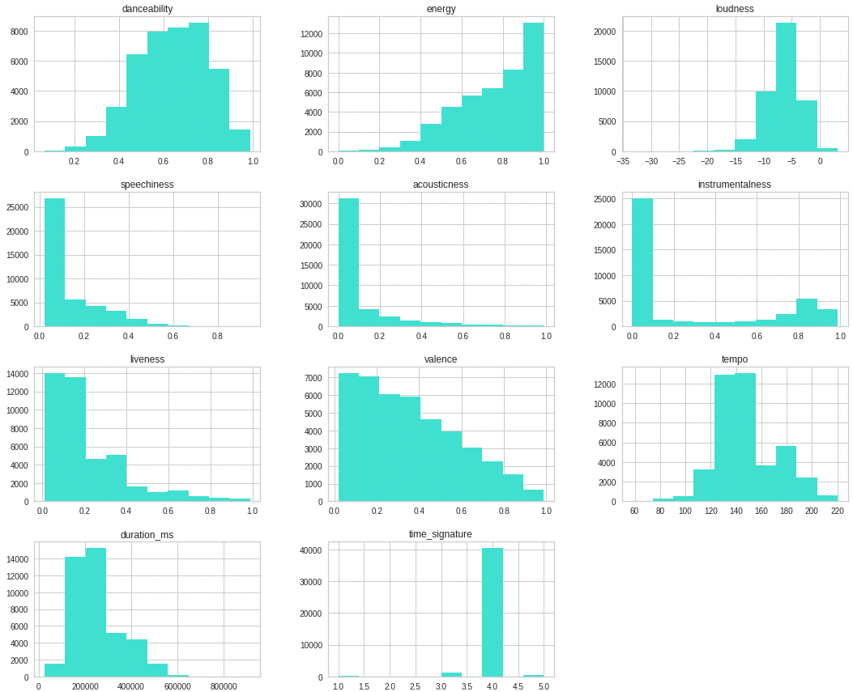
EDA & Findings
EDA-numerical data
(1) Missing rate, (2) Historical gram, (3) Missing data, (4) outliers, (5) Normalize
EDA-Categorical data
(1) Missing data, (2) List, (3) missing data, (4) Categorical to numerical
Notes:
EDA
Data cleansing
Findings

Slide 20
How will we solve the problem?
Song title - multiclass classification
more rnb songs have ‘love’, etc.
smaller dataset. (Non english songs in dataset)
Business case (algorithm and classify it for spotify internally)
Song recommendation (KNN, kmeans, etc.)
Similar song played next?
business scenario of the next closest song
Song with a different genre
Measure of success

Slide 21
Baseline Model
Model creation
Model 1 – Gradient Boosting Machine
Model 2 – Random forest
Model 3 – Neural Network model
Model 4 – KNN
Model 5 – GMM
Hyper parameter tuning / cross validation
Model testing performance / Model evaluation
Notes:
Not required to have a baseline model for our baseline presentation, but it might be good to have.

Slide 22
How will we solve the problem?
KNN algorithm (Supervised Learning)
Classify songs based on the similarities in earlier stored song characteristics.
Identify meaningful groups and clusters based on similarities in song characteristics.
Make predictions
Multiclass classification (Supervised Learning)
Categorize song genre based on similar song characteristics.
Make predictions.
Measure success
Notes:
Can discuss why we decided on KNN vs. Kmeans.
KNN - K-nearest neighbours is a supervised machine learning technique [5] that takes a data point and calculates the distance between k number of labelled data points, classifying the point based on the number of votes that it gets from the k-nearest data points. The ‘supervised’ part means that we already know what genre the song is before we test it

Slide 23
Baseline Model
Model creation
Multiclass - logistic regression (20% so far….)
Kmeans
KNN
Gradient Boosting
Random forest
Neural Network
Hyper parameter tuning / cross validation
Model testing performance / Model evaluation
Notes:
Not required to have a baseline model for our baseline presentation, but it might be good to have.

Slide 24
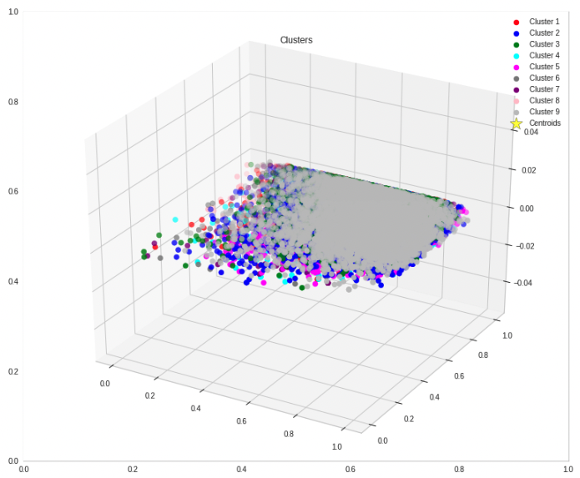
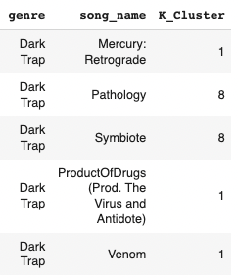
Kmeans Process
Organize our songs into clusters based on common song characteristics
Organize our songs into clusters based on common song characteristics
Notes:
DAISY
With kmeans clustering, the first step is to choose a value for K (number of clusters we’d like to place the observations in). And we chose 9, for the 9 genre types.
Still working on the prediction accuracy.

Slide 25
Random Forest (sklearn)
Results
Hyperparameters
max_depth=None
n_estimators=460,
criterion='gini',
max_features = 'sqrt',
min_samples_split = 6,
min_samples_leaf=9
The rest are the default parameters
Notes:
Ivan

Slide 26
XGBoost (sklearn)
Hyperparameters
max_depth=3
n_estimators=280,
learning_rate=0.1
The rest are the default parameters

Slide 27
Deep Neural Network (tensorflow)
Work in progress…
Validation accuracy is zero on every epoch.
Training accuracy is not greater than 20%.
Some more debugging needs to be done.
Notes:
Ivan

